Slide 1
TripAdvisor Dataset Analysis
Akshat Bharadwaj
The LNMIIT, Jaipur

Slide 2
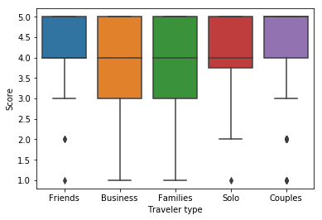
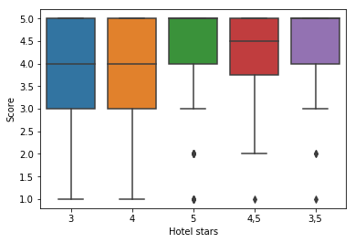
Dataset, and Features:
The target was to predict the Score variable of the dataset for an oncoming review.
Graphical analysis:

Slide 3
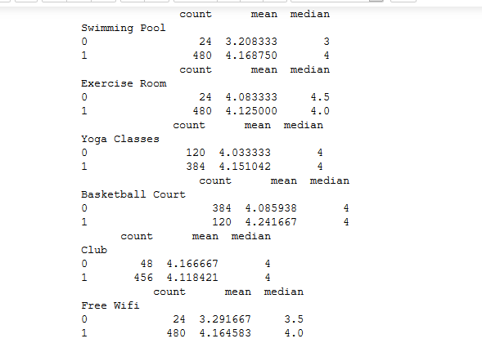
Based on these features as well as employing SelectKBest with univariate filtering, we arrived at the following list of optimal features:
Amenities such as Swimming Pool, Basketball Court, Free Wifi, and Has Casino
Traveler type
Hotel stars
User continent

Slide 4


Predictions: After applying a host of algorithms such as Random forests, GBC, SVC, etc in sklearn and beyond, we settled on the mord package in Python, which provides some algorithms on Ordinal Regression. It ended up giving us marginally better results than the rest.
The algorithm works on computing logits:
It computes logits of the cumulative probabilities of the target variable, and then computes the likelihood estimates for each of the target variables based on the logits computed.
Likelihood is a way of determining the extent of how much given samples support a given variable, say, Score.

Slide 5
Results: The results we obtained were not very encouraging. We obtained a max prediction accuracy of around 50% using accuracy_score as a metric, and obtained an averaged mean_squared error of around 1.18.
It is worth mentioning that we used Stratified K-Fold for obtaining our final metrics.
As mentioned earlier, the metrics used were:
accuracy_score (when treating it as a classification task)
mean_squared_error (when treating it as a regression task)
We felt that the problem could be modelled either way, as a regressive or a classification task. When using regressors for predicting the target variable, we applied np.round() to the outcome.
Possible reasons for low accuracy:
Heavily left skewed dataset(Higher values were generally preferred)
Small data size
Very less significant continuous features
Ratings are generally affected by user experience, which was absent from the feature list

